Slide 1


Amazon Sales Data Analysis
Detailed Project Report
Presented By :
Mayank Yadav
Nitish kr. Dash
(Business Analyst Intern)

Slide 2
Project Detail
Project Title | Analyzing Amazon Sales Data
Technology | Business Intelligence
Domain Name | E-commerce
Project Difficulty Level | Advanced
Tools | Microsoft Excel, Power BI, MySQL

Slide 3
Agenda
Problem Statement
Primary goals
Insights
Dashboard
Recommendation

Slide 4
Problem Statement
Sales management has gained importance to meet increasing competition and the need for improved methods of distribution to reduce cost and to increase profits. Sales management today is the most important function in a commercial and business enterprise.
Do ETL : Extract-Transform-Load some Amazon dataset and find Sales-trend -> month wise , year wise , yearly month wise
Find key metrics and factors and show the meaningful relationships between attributes.

Slide 5


Primary goals
The primary goal of an Amazon sales data analysis project is to uncover actionable insights that can drive business decisions and improve overall performance. This can include identifying trends in sales patterns, understanding customer behavior, optimizing product offerings, and enhancing marketing strategies.
By analyzing sales data, the aim is to identify areas of strength and areas for improvement within the Amazon marketplace, ultimately leading to increased revenue, customer satisfaction, and competitive advantage.
Additionally, the project may focus on identifying opportunities for operational efficiencies, such as supply chain optimization or inventory management improvements. Overall, the primary goal is to leverage data-driven insights to drive growth and success within the Amazon ecosystem.
ANNUAL REVENUE GROWTH

Slide 6


Tools Used:
Microsoft Excel
MySQL
Power BI
Approach Used:
Data Wrangling
Feature Engineering
Exploratory Data Analysis

Slide 7

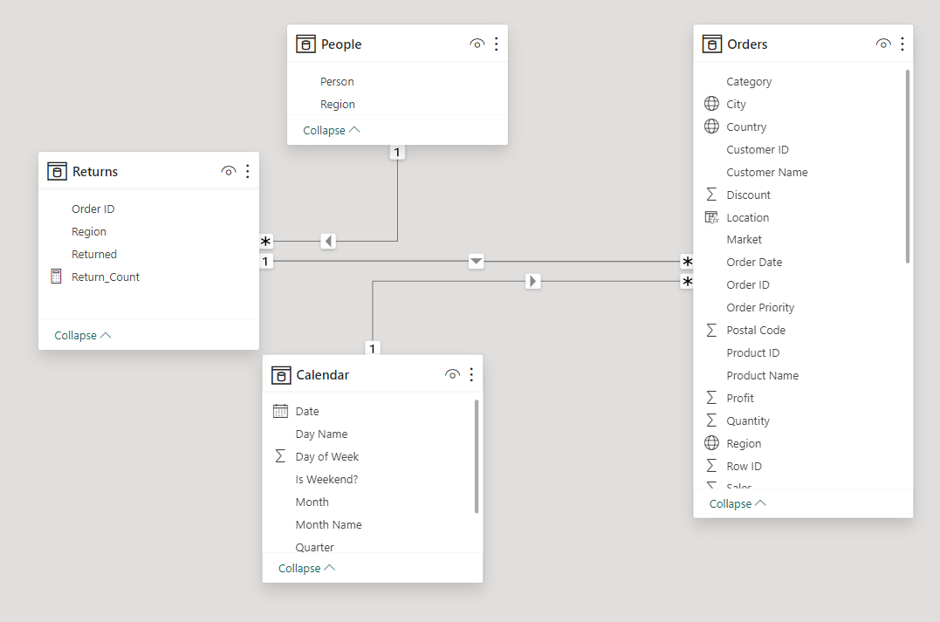
ER Diagram

Slide 8
Sales and Profit Analysis
In 2012, the Technology category emerged as the market leader with total sales reaching approximately $8 lakh marking a 22% increase over Office Supplies which have the lowest sales at $7 lakh.
& there is largest divergence between Total Sales and Total Profit within the Technology sector, with sales surpassing profit by $7 lakh, indicating substantial investment and possibly higher costs associated with technological advancements.
The following year, 2013, we continued to see that the Technology leading the charge with total sales of around $10 lakh, a 29% leap from Office Supplies' sales of $8 lakh.
A positive correlation between Total Sales and Total Profit was noted, suggesting a more efficient conversion of sales into profit.
Despite this, the Technology category still experienced a significant gap where sales exceeded profit by $7 lakh, reflecting a consistent pattern of high revenue yet considerable costs.

Slide 9
Sales and Profit Analysis
In 2014, with Technology sales climbing to $12 lakh, more than Office Supplies by 26.36%.
Technology's share of Total Sales was 38%.
However, the gap between Total Sales and Total Profit widened further, with sales exceeding profit by an impressive $11 lakh, hinting at aggressive market expansion strategies and possibly increased production and operational expenses.
By 2015, the gap between the highest and lowest sales categories narrowed slightly, with Technology sales at $16 lakh, only 23.77% higher than Office Supplies.
The positive correlation between Total Sales and Total Profit remained intact, reinforcing the notion of effective sales-to-profit conversion.
Yet, the Technology sector continued to show the most significant disparity between sales and profit, with a difference of $14 lakh, potentially indicating a sustained reinvestment into technological innovation.

Slide 10
Sales and Profit Trends
2) For the year 2012
In the first quarter of 2012 (January to March), sales rose steadily from $0.10 million to $0.14 million, showing a 40% increase. This positive growth marked a strong start to the year. However, in April, sales dropped to $0.11 million, a 21% decrease from March. The months following May showed sales fluctuating around $0.20 million, indicating market variability.
From July to September, sales remained stable at around $0.21 million, possibly suggesting a consistent customer base or market saturation. The most notable change occurred in December, with sales soaring to $0.32 million.
2) For the year 2013
From January to March 2013, there was a decrease in sales from $0.14 million to $0.10 million, showing negative growth. However, from March to May, sales significantly increased to $0.21 million, more than doubling within this period.
In July, there was a slight drop in sales to $0.15 million. From September to November, sales remained steady around $0.30 million, indicating a plateau phase.

Slide 11
Sales and Profit Trends
3) for 2014
The monthly sales go up and down a lot, like a roller coaster. This might be because of things like seasons or other factors that change over time.
Sales were really high in July and November, which could be because of special events or holidays.
Sales dropped a lot in February, possibly because the excitement of the holidays was over, or because the market wasn't doing well.
From February to July, sales kept going up, more than doubling. This could be because of good marketing or more people buying things.
Sales went down a little in September but then went back up again. This shows that the business was able to deal with challenges well.
Sales were really high again in November, maybe because of Black Friday or end-of-year shopping.

Slide 12
Sales and Profit Trends
4) for 2015
Here’s a simplified statistical analysis of the monthly sales data for 2015:
Sales started at $180,000 in January and gradually increased, showing positive growth for the first quarter.
May saw the highest sales at $290,000, indicating a strong performance halfway through the year, possibly due to promotions or clearing out stock.
In July, Sales dropped sharply to $240,000, possibly due to market corrections or seasonal slumps.
After July, sales started recovering and continued to rise steadily, suggesting market resilience and effective sales strategies.
& at the Year-End November recorded the highest sales at $560,000, likely due to holiday season effects or year-end sales pushes.

Slide 13

Insights
Technology Dominance
Revenue Growth
Profit Margin Challenges
Seasonal Trends
Market Resilience
Effective Sales Strategies

Slide 14
Insights
Based on the provided data spanning from 2012 to 2015, here are the insights:
- Technology Dominance: Across all years, the Technology category consistently emerged as the market leader, surpassing Office Supplies & furniture in sales. Its dominance was particularly notable in 2014 and 2015, where Technology sales significantly outpaced other categories.
- Revenue Growth: Over the four-year period, there was a consistent trend of increasing total sales, indicative of overall market growth and potentially effective marketing strategies or product innovations driving consumer demand.
- Profit Margin Challenges: Despite impressive sales figures, the Technology sector consistently faced challenges in converting sales into profit, as evidenced by the substantial gaps between total sales and total profit. This suggests higher operational costs, possibly due to investments in technological advancements, market expansion efforts, or competitive pricing strategies.
.

Slide 15
Insights
- Seasonal Trends: Each year exhibited seasonal fluctuations in sales, with certain months experiencing peaks or troughs. For instance, sales tended to rise during holiday seasons or promotional events like Black Friday, while experiencing drops during off-peak periods or market corrections.
- Market Resilience: Despite fluctuations, there were instances of market resilience, as seen in the ability of sales to rebound after temporary declines, indicating adaptability and effective management strategies to navigate challenges.
- Effective Sales Strategies: Towards the end of each year, there was a notable uptick in sales, possibly driven by year-end promotions, holiday season effects, or strategic sales pushes. This suggests the effectiveness of targeted sales strategies in capitalizing on consumer behaviour and maximizing revenue opportunities.
Overall, the data underscores the importance of continuous market analysis, strategic planning, and adaptability to maintain competitiveness and profitability in a dynamic business environment.

Slide 16
Recommendation
Diversification and Market Expansion
Seasonal Marketing & Promotions
Cost Management
Customer Engagement
Inventory Management & Forecasting
International Expansion & Localization

Slide 17
Recommendations
1. Diversification and Market Expansion:
- Explore diversification opportunities beyond the Technology category to mitigate over-reliance on a single sector.
- Invest in market expansion initiatives targeting emerging markets or niche segments to broaden customer base and revenue streams.
2. Seasonal Marketing and Promotions:
- Capitalize on seasonal peaks such as holiday seasons, Black Friday, and year-end sales by implementing targeted marketing campaigns and promotional offers to drive sales volume.
- Leverage data-driven insights to anticipate and respond effectively to seasonal fluctuations in consumer demand.

Slide 18
Recommendations
3. Operational Efficiency and Cost Management:
- Implement cost optimization measures across the supply chain, including procurement, logistics, and fulfilment, to improve profit margins and streamline operations.
- Leverage advanced analytics and automation technologies to enhance operational efficiency and reduce overhead costs.
4. Customer Engagement and Experience Enhancement:
- Prioritize customer-centric initiatives focused on enhancing shopping experience, personalized recommendations, and after-sales support to foster brand loyalty and drive repeat purchases.
- Leverage customer feedback and data analytics to identify areas for improvement and tailor offerings to meet evolving consumer preferences.

Slide 19
Recommendations
5. Inventory Management and Forecasting:
- Implement robust inventory management systems supported by data analytics and demand forecasting models to optimize stock levels, minimize stockouts, and reduce holding costs.
- Foster collaboration between sales, marketing, and supply chain teams to align inventory strategies with sales projections and market demand.
7.International Expansion and Localization:
- Explore opportunities for international expansion in high-growth markets while prioritizing localization efforts to adapt offerings to local preferences and regulatory requirements.
- Invest in market research and strategic partnerships to navigate cultural nuances, regulatory complexities, and competitive landscapes in target regions.
Conclusion:
By strategically aligning sales and profit optimization strategies with market dynamics and consumer preferences, Amazon can sustain growth, enhance profitability, and maintain its position as a market leader in the e-commerce industry.

Slide 20




Thank you

